Slide 1



Self-Leadership for Effective Leadership – Parable of the Tenants
Elder Chuck Latham
Book of Acts Nation Leadership Conference 2025

Slide 2


BOAN
Overview
Parable of the Tenants
What It Means in the Natural
Spiritual Application
Leadership Application
Case Study Examples
Quick Comment About AI
Summary
“While this parable primarily addresses the failure of Israel’s religious leaders, the principle is still true for us: God expects fruit from what He has invested in us.”

Slide 3
Case Study Scenario
Jordan is a mid-level project manager at a government agency. Her team is working on a high-profile project with tight deadlines and lots of visibility. A peer manager, Carlos, consistently misses deliverables that affect Jordan’s timeline. To make matters worse, Carlos blames Jordan’s team in meetings, creating tension and undermining her credibility.
Jordan feels:
Frustrated and disrespected
Pressured to defend herself
Tempted to speak poorly about Carlos to upper management
Jordan believes in her faith but hasn’t been practicing intentional spiritual self-leadership lately.
BOAN

Slide 4
Matthew 21
³³ “Listen to another parable: There was a landowner who planted a vineyard. He put a wall around it, dug a winepress in it and built a watchtower. Then he rented the vineyard to some farmers and moved to another place. ³⁴ When the harvest time approached, he sent his servants to the tenants to collect his fruit.
BOAN

Slide 5
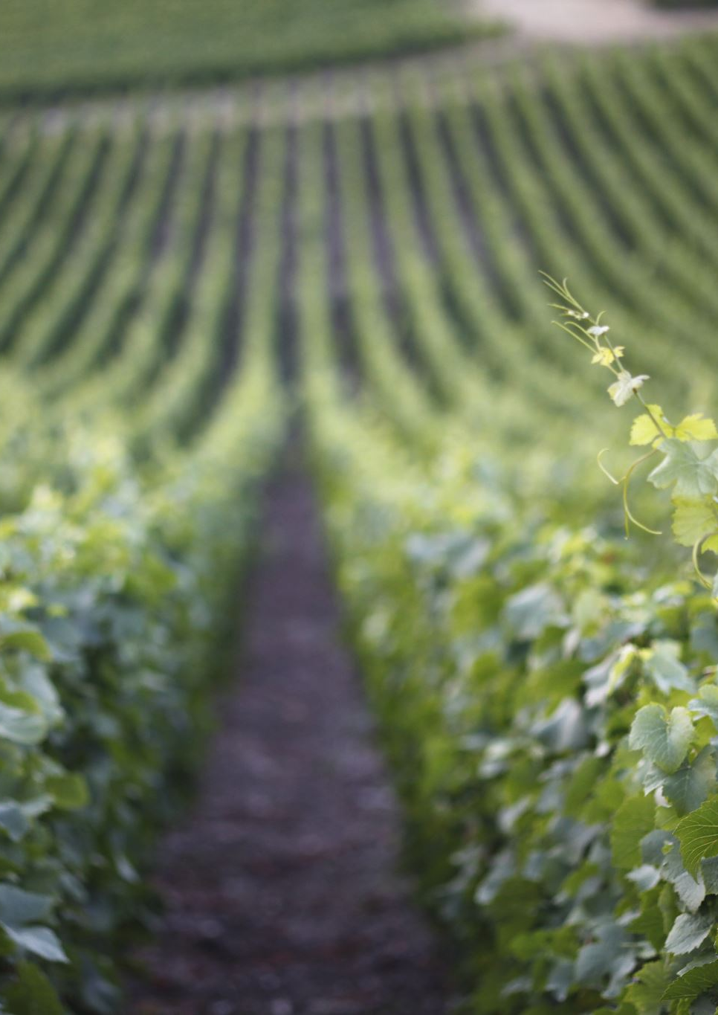
Observations in the Natural - Elements
Landowner – owner of the vineyard
Vineyard – field, where seeds are planted
Wall – fence used for protection and separation
Winepress – vat used to crush grapes and produce wine/product
Watchtower – provides high vantage point, protect against attacks
Tenants – renters who work and manage the vineyard
Harvest time – vineyard produces final product
Servants of landowner – collect the produce
Notes:
They are like sharecroppers. They manage and work the land. This is a parable – a story in the natural to help you understand the spiritual application of how the Kingdom operates.

Slide 6
Spiritual Representation
Landowner – God, the provider who gives what is needed
Vineyard – the mind/heart where seeds are planted (Israel)
Wall – God’s protection and separation
Winepress – process for producing fruit
Watchtower – oversight and guidance, warnings
Tenants – religious leaders given responsibility to manage production
Harvest time – Spiritual fruit
Servants of landowner – prophets sent to call Israel to repentance

Slide 7
Evil Tenants
³⁵ “The tenants seized his servants; they beat one, killed another, and stoned a third. ³⁶ Then he sent other servants to them, more than the first time, and the tenants treated them the same way. ³⁷ Last of all, he sent his son to them. ‘They will respect my son,’ he said.
³⁸ “But when the tenants saw the son, they said to each other, ‘This is the heir. Come, let’s kill him and take his inheritance.’ ³⁹ So they took him and threw him out of the vineyard and killed him.
BOAN

Slide 8
Observations
The tenants (religious leaders) didn’t want to give up control
They wanted the fruit and inheritance that belonged to the Owner
The Owner sends His son – a picture of God sending Jesus
These gangster tenants kill the Son
Does this parable sound familiar?
  This is the ministry of Christ – religious leaders killed him
  Trying to hold onto something that didn’t belong to them
  This is a foresight of end time prophecy
Notes:
Identification of the Characters
• Landowner: Represents God, who established Israel as His chosen people.
• Vineyard: Symbolizes Israel, often depicted as God's vineyard in the Old Testament (Isaiah 5:1-7).
• Tenants: The religious leaders and people of Israel entrusted with God's vineyard.
• Servants: The prophets sent by God, many of whom were mistreated or killed.
• Son: Jesus Himself, the beloved Son sent by God.

Slide 9
Judgement to Come
⁴⁰ “Therefore, when the owner of the vineyard comes, what will he do to those tenants?” ⁴¹ “He will bring those wretches to a wretched end,” they replied, “and he will rent the vineyard to other tenants, who will give him his share of the crop at harvest time.”
⁴² Jesus said to them, “Have you never read in the Scriptures:
“‘The stone the builders rejected
has become the cornerstone;
the Lord has done this,
and it is marvelous in our eyes’?
⁴³ “Therefore I tell you that the kingdom of God will be taken away from you and given to a people who will produce its fruit. ⁴⁴ Anyone who falls on this stone will be broken to pieces; anyone on whom it falls will be crushed.”
BOAN
Notes:
The importance of these spiritual principles is better understood when we understand the Hebrew definitions of “feast” and “Convocation”.

Slide 10
The Ministry of Christ – Mercy & Warning
Christ asks a question for the purpose of reflection and repentance
  That is still a tool used by the Holy Spirit; don’t accuse before asking the right question
Jesus follows up with Psalm 118
  He is the stone they rejected instead of being the foundation to build upon
  God will use what was rejected and do something wonderful
The Kingdom will be taken from them and given to others to work
Taken from those leaders and given to Gentiles?
Last sentence, it is better to be broken than crushed…part of the process
Notes:
Jesus’ rejection, death and resurrection is indeed marvelous in our eyes.
As we all should, Christ places Himself in the story. If He is the cornerstone, then these religious leaders must be the ones who are rejecting him and trying to build the church without him and for their own glory and liking.
ChatGPT:
Falling on the Stone – Broken in Repentance (Humility & Salvation)
Those who "fall" on Jesus, the cornerstone, in humility and repentance will be broken—meaning their pride, self-reliance, and sin will be shattered. But this "brokenness" leads to salvation and new life in Christ.
The Stone Falling – Final Judgment (Rejection & Destruction)
For those who reject Christ, the same stone will fall on them in judgment. This represents the final, crushing destruction of those who persist in unbelief.
Application
We can either humble ourselves before Christ and be "broken" in a way that leads to restoration,
Or, if we reject Him, we will face the inescapable judgment of God.
One of the class members noted, when we fall on the stone, our weight is on the stone and it can handle and support us.

Slide 11
Jesus is Talking to Jewish Leaders Then…Is He Also Talking to Us Now?
Yes! I see process…and if process, it works the same way today
Has the Owner assigned us a work to do?
Has He given us something to take care of that truly belongs to Him?
Will He return for looking for fruit based upon our management?
Are we trying to hold on to something that really belongs to Him?
Have we considered using Christ as the cornerstone for this work?
Notes:
Think about this…..is there something He has placed us in charge of, with instructions on how to build?
Is Christ the cornerstone of the management decisions you are making and about to make?

Slide 12
Spiritual Application – The Steps
What God Provided
The Steps – Process Management
Vineyard – a need
A fence - for protection
Winepress – refinement
Watch tower – intel, warning
There is a gap – growing season, where God will return looking for fruit
The Cross – a need
Grave – separation from past
New Life – resurrection, hope
Holy Spirit – our guide, power
There is a gap – called the church age where Jesus will return looking for fruit
BOAN
Notes:
The feasts are divided into two phases, Spring and Fall Feasts. The Spring Feasts outline how to establish justification with God. It is how we are in right standing in relationship with God.
Fall Feasts outline how we interact with others.
Jesus fulfilled the Spring Feasts and will fulfill the Fall Feasts with his return. The feasts are spiritual principles which apply to everyone and all situations. The sun comes up and the sun goes down. These steps are followed by the Children of Israel, God leads them out of bondage through the application of these steps. The plan He uses for Israel is the same plan for us in all aspects of the Kingdom.

Slide 13
Fall Steps – End Time Management
What God Expects
The Steps – Process Management
Fruit of the Spirit, increase
Harvest – separate good/bad
Rest, peace
What you produce doesn’t belong to you, we work for Him
Rapture – we extend mercy
2nd Coming – atonement Victory
Christ reigns - peace
Our faithfulness produces Kingdom results and rewards/promotion
BOAN
Notes:
I see the need to plant the seeds and receive the vineyard.
God provides protection and separates me from my past and enemies.
I have hope that there will be something good and useful coming out of this process (winepress).
The Holy Spirit is given to provide guidance and carefully watch over the vineyard.
The vineyard is given to us to produce fruit. Notice, the landowner is absent, but is coming back. Likewise, the watchtower is in place to guide the farmers in their work until He returns.
Harvest time comes, fruit has been produced and we need to be careful that our lives and actions produce results that God is looking for. We don’t hold things back and produce this as if we are working for ourselves. Not about us which is a key factor in the Day of Atonement against self-righteousness.
Jesus is coming, we will either have peace with him, or judgement is coming.

Slide 14
Tenant Comparison
Gangster Tenants
Righteous Tenants
Start out with the first 4 steps
Produce fruit
Fruit-jackers, steal what doesn’t belong to them
Will abuse servants
No reverence for the Son
Payday is coming
Provided the first 4 steps
Produce fruit
Don’t steal from God
Happy to present fruit when He comes
Always reverence the Son
Bless His servants
Will receive a great reward
BOAN
Notes:
Protection & Separation – That wall around the vineyard is God’s covering, keeping us from falling back into old habits or letting the enemy steal what He’s growing in us.
The wall (hedge) reminds us that God sets us apart from our past sins, mistakes, and enemies.
Personal Application: Am I staying inside the protection of God’s will, or am I trying to break out into old habits and worldly ways?
Personal Application: Do I see trials as part of God’s refining process, preparing me for something greater?
Personal Application: Am I listening to the Holy Spirit’s guidance in my decisions, or am I trying to manage my vineyard on my own?
Harvest & Surrender – The fruit isn’t ours to hoard. This step hits deep—it’s about selflessness, surrender, and making sure our work aligns with God’s purpose, not our own agendas.
When harvest time comes, what we have produced will be tested.
Some try to keep the fruit for themselves (self-righteousness, pride, or selfish ambition), forgetting that everything belongs to God. The Day of Atonement is a reminder that our works are not about us—it’s about God’s glory.
Personal Application: Am I working for God’s glory or my own? Am I giving Him what He deserves, or am I holding something back?

Slide 15
Self-Management Process
Vineyard Element | Spiritual Symbol | Self-Leadership Parallel
Planted the vineyard | Cross – Foundation of new life | Submitting to Christ’s Lordship
Put a wall around it | Grave – Separation from the world | Boundaries, discipline, dying to self
Dug a winepress | Resurrection/Hope – processing pressure | Growth through trials, emotional regulation
Built a watchtower | Holy Spirit – discernment, vigilance | Alertness, self-awareness, Spirit-led choices

Slide 16
Application for Self-Management
Follow the process, step by step
Don’t try to manage anybody or any situation until you apply what God has provided (Cross, Grave, New Life, Holy Spirit)
Don’t let success go to your head, don’t steal His glory
In every management situation, you are working for and represent the Kingdom
How often should we follow these Kingdom management steps?
  How often are we to pick up the cross?
  Repeating the process keeps us in right standing

Slide 17
What Does Fruit Look Like
You better find out what He is looking for
Spiritually – Galatians 5, John 15, Matthew 25, Luke 4
Professionally – Luke 3:11-14
BOAN
Notes:
Protection & Separation – That wall around the vineyard is God’s covering, keeping us from falling back into old habits or letting the enemy steal what He’s growing in us.
The wall (hedge) reminds us that God sets us apart from our past sins, mistakes, and enemies.
Personal Application: Am I staying inside the protection of God’s will, or am I trying to break out into old habits and worldly ways?
Personal Application: Do I see trials as part of God’s refining process, preparing me for something greater?
Personal Application: Am I listening to the Holy Spirit’s guidance in my decisions, or am I trying to manage my vineyard on my own?
Harvest & Surrender – The fruit isn’t ours to hoard. This step hits deep—it’s about selflessness, surrender, and making sure our work aligns with God’s purpose, not our own agendas.
When harvest time comes, what we have produced will be tested.
Some try to keep the fruit for themselves (self-righteousness, pride, or selfish ambition), forgetting that everything belongs to God. The Day of Atonement is a reminder that our works are not about us—it’s about God’s glory.
Personal Application: Am I working for God’s glory or my own? Am I giving Him what He deserves, or am I holding something back?

Slide 18

Case Study

Slide 19
Case Study Scenario
James and Alisha have been married for 12 years. Recently, their communication has become strained. James has been working long hours and comes home emotionally drained. Alisha, who manages most of the responsibilities at home, feels unseen and unheard. She’s tried to initiate conversations about feeling disconnected, but James often responds defensively or retreats into silence.
Last night, after Alisha mentioned how she feels alone in the marriage, James muttered, “You’re always complaining—nothing I do is ever enough.” Alisha felt crushed. She wanted to lash out, list everything she does for the home and kids, and demand that he change.
But instead of reacting, she decides to pause and reflect on how to self-lead using the first four steps of her spiritual process.

Slide 20
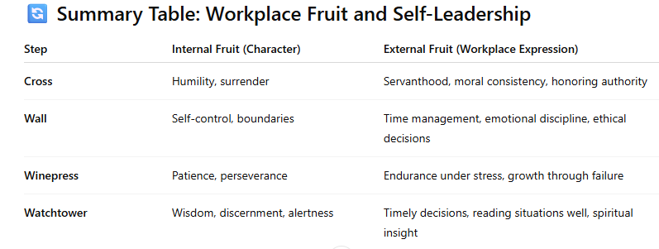
Colossians 3:17 "And whatever you do, whether in word or deed, do it all in the name of the Lord Jesus, giving thanks to God the Father through him."

